Slide 1
MAT199: Math Alive
Voting, Power, and Sharing
Ian Griffiths
Mathematical Institute, University of Oxford,
Department of Mathematics, Princeton University

Slide 2
A dinner party
To celebrate the start of the Math Alive lectures we decide to go out to dinner.
Because there are a lot of us, Winberie’s can only offer a set menu.
They give us a choice of chicken or salmon.

Slide 3
A dinner party
To celebrate the start of the Math Alive lectures we decide to go out to dinner.
Because there are a lot of us, Winberie’s can only offer a set menu.
They give us a choice of chicken or salmon.
A quick poll shows that more of us prefer salmon than chicken.
So we go with salmon.

Slide 4
A dinner party
To celebrate the start of the Math Alive lectures we decide to go out to dinner.
Because there are a lot of us, Winberie’s can only offer a set menu.
They give us a choice of chicken or salmon.
A quick poll shows that more of us prefer salmon than chicken.
So we go with salmon.
When we call the restaurant they inform us that the salmon is off and it has been replaced with beef.
We do another quick poll and find that more of us prefer the chicken than the beef.

Slide 5
A dinner party
To celebrate the start of the Math Alive lectures we decide to go out to dinner.
Because there are a lot of us, Winberie’s can only offer a set menu.
They give us a choice of chicken or salmon.
A quick poll shows that more of us prefer salmon than chicken.
So we go with salmon.
When we call the restaurant they inform us that the salmon is off and it has been replaced with beef.
We do another quick poll and find that more of us prefer the chicken than the beef.
We call back to confirm we would like chicken and Winberie’s inform us that the chicken is now off but the salmon is back on.
The choice is now salmon or beef.
Do we need to do another poll to make sure the majority get the one they prefer?

Slide 6
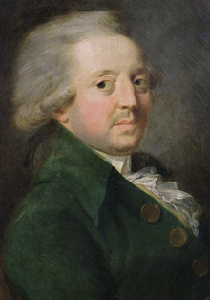
Nicolas de Caritat – Marquis de Condorcet
1743 – 1794
Notes:
French philosopher, mathematician and political scientist.

Slide 7
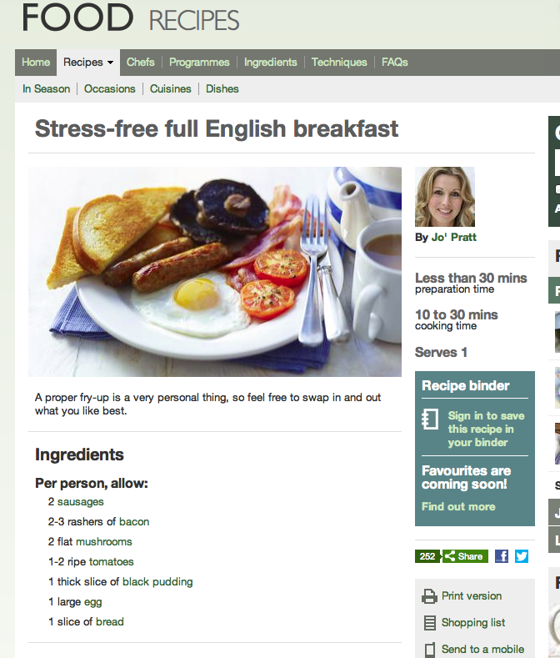
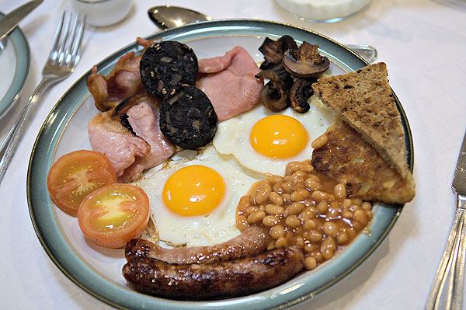
Full English breakfast
1743 – 1794

Slide 8
Summary of lecture 1
Voting and social choice
Paradoxes can arise when ranking preferences (our Winberie’s dinner experience).
A clear winner is called a Condorcet winner. If there isn’t a clear winner there are various ways of selecting the winner:
Plurality – the choice with the most first places wins.
Plurality with run-off – the two people with the most and second-most first places are pitted against one another in another election.
Sequential run-off (the Hare system) – eliminate the bottom candidate at each round.
Borda count – assign a score for top choice, second choice, and so on, and add up the total scores. The winner is the one with the highest score.

Slide 9
Office hours
We have lots of AIs to help you!
They will offer office hours when you can come along to ask questions (Weeks 2-12 inclusive):
Monday 3:30–4:30. Fine Hall Room 219. Benno Mirabelli.
Tuesday 3–4. Fine Hall Room 219. Yuan Liu.
Wednesday 2–3. Fine Hall Room 209. Me ☺
Wednesday 4–5. Fine Hall Third Floor Common Room. Miranda Moore.
Thursday 1–2. Sherrard Hall Room 005. Yuan Cao.
Friday 11-12. Fine Hall Room 219. Yuehaw Khoo.

Slide 10
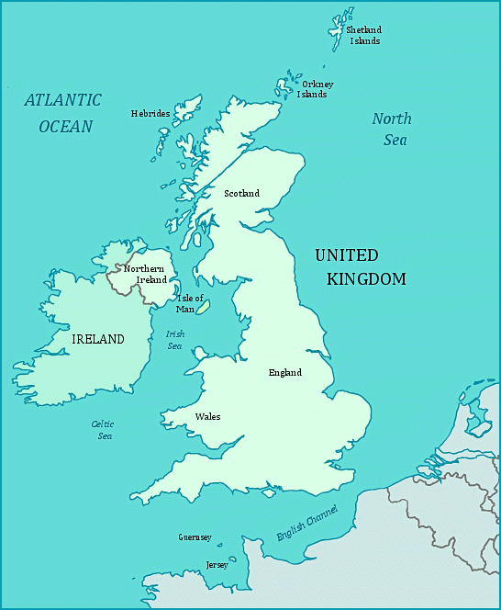
Holiday destinations
Cornwall

Slide 11
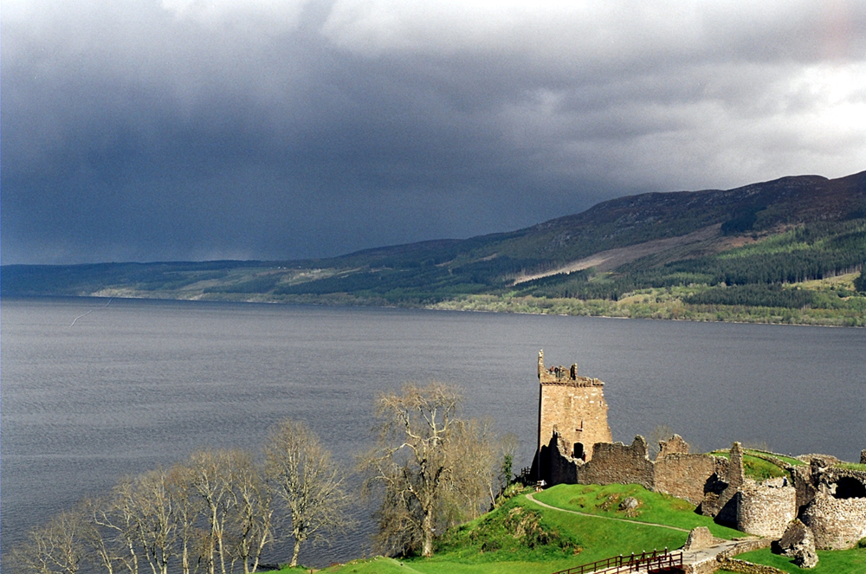
Holiday destinations
Scotland

Slide 12
Holiday destinations
Jersey (the real one)

Slide 13
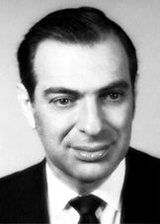
Kenneth Arrow
Born in 1921

Slide 14
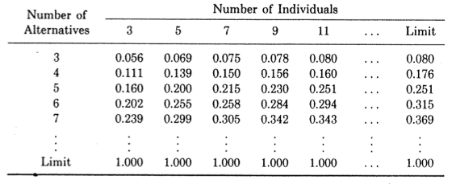
Table showing fraction of non-Condorcet winners

Slide 15
Summary of lecture 2
If there isn’t a clear (Condorcet) winner then the way in which you determine the winner often leads to a different result.
You cannot produce a universal fair voting scheme (proof by Kenneth Arrow).
…but provided there aren’t too many choices, it is likely that you get a Condorcet winner anyway so there is no issue.
Today: Fair Division. How do we share things out fairly?

Slide 16
Summary of lecture 2
If there isn’t a clear (Condorcet) winner then the way in which you determine the winner often leads to a different result.
You cannot produce a universal fair voting scheme (proof by Kenneth Arrow).
…but provided there aren’t too many choices, it is likely that you get a Condorcet winner anyway so there is no issue.
Today: Fair Division. How do we share things out fairly?
Something to think about while we are waiting to begin – can you work out the relevance of this song?

Slide 17
Summary of lecture 3
A cake may be shared three ways in an envy-free way.
Generalization for four ways is harder (Brams and Taylor, 1992).
There is no clear way of generalizing this for five or more people.
We may divide up several items two ways in an envy-free way (e.g., a divorce settlement).
We can divide up several items more than two ways in a fair but not envy-free way (e.g., dividing up an estate).

