Slide 1
Welcome back!
It’s spring…or supposed to be ☺

Slide 2
MAT199: Math Alive
Cryptography
Ian Griffiths
Mathematical Institute, University of Oxford,
Department of Mathematics, Princeton University

Slide 3
Cryptography:
What is it and why do we need it?
The need to transfer important information in a secure way is vital, e.g.,
Purchasing goods on the internet

Slide 4
Cryptography:
What is it and why do we need it?
The need to transfer important information in a secure way is vital, e.g.,
Purchasing goods on the internet
Transmitting private messages

Slide 5
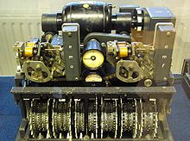
Cryptography:
What is it and why do we need it?
The need to transfer important information in a secure way is vital, e.g.,
Purchasing goods on the internet
Transmitting private messages
Communicating strategies to allies in a war

Slide 6
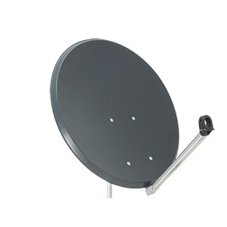
Cryptography:
What is it and why do we need it?
The need to transfer important information in a secure way is vital, e.g.,
Purchasing goods on the internet
Transmitting private messages
Communicating strategies to allies in a war
Transmitting TV signals to subscribers

Slide 7
Cryptography:
What is it and why do we need it?
However, the ability for external parties to access this important information is just as desirable (if not more so), e.g.,
obtaining credit card details

Slide 8
Cryptography:
What is it and why do we need it?
However, the ability for external parties to access this important information is just as desirable (if not more so), e.g.,
obtaining credit card details
intercepting private messages

Slide 9
Cryptography:
What is it and why do we need it?
However, the ability for external parties to access this important information is just as desirable (if not more so), e.g.,
obtaining credit card details
intercepting private messages
having an advantage over enemies in war

Slide 10
Cryptography:
What is it and why do we need it?
However, the ability for external parties to access this important information is just as desirable (if not more so), e.g.,
obtaining credit card details
intercepting private messages
having an advantage over enemies in war
accessing TV stations without subscribing

Slide 11
How can information be transmitted securely?
How can we transfer some information from one place to another without an intermediate observer being able to read the information?
Notes:
Cryptography video

Slide 12
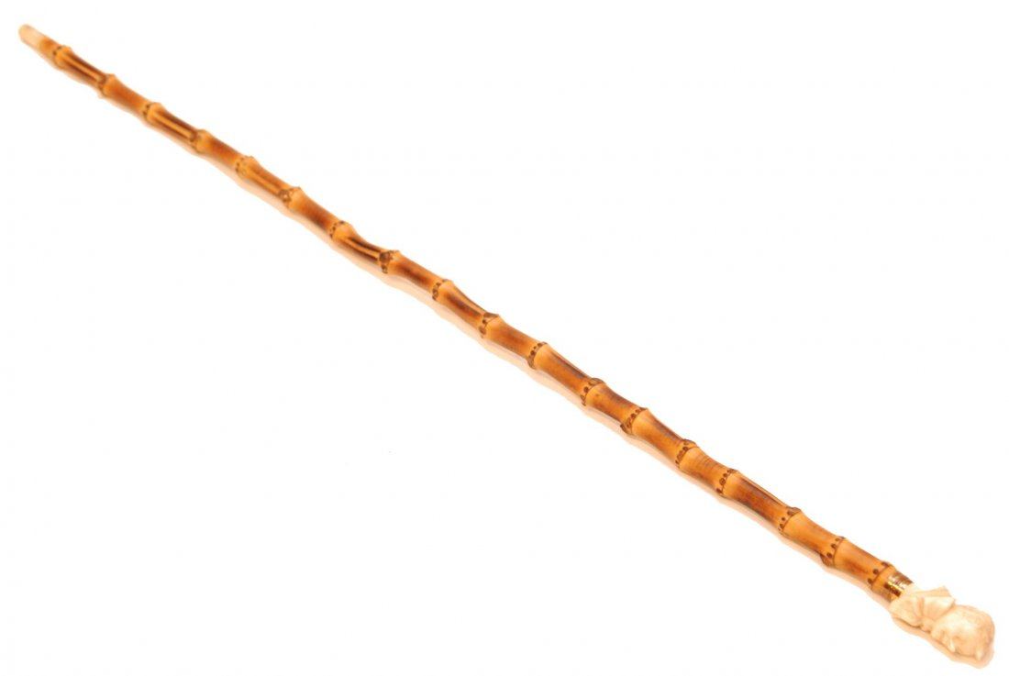
Simple coding strategies
An ancient way of encrypting a message used by the Chinese was to wrap paper around a cane with a particular size and write the message. When the paper is unwrapped from the cane the message is encrypted and can only be understood when wrapped around a cane with the same diameter.
Notes:
Bamboo cane experiment - scytale
Tattoos on heads of slaves

Slide 13
Simple coding strategies
Transliteration schemes and substitution ciphers

Slide 14
Simple coding strategies
Transliteration schemes and substitution ciphers
Another simple way of coding a message is to replace each letter with another random one:
To decode the message we just work in the opposite direction.

Slide 15
Simple coding strategies
Transliteration schemes and substitution ciphers
You can use simple transliterations that involve just a shift in the alphabet:
These are called Caesar codes.

Slide 16
Simple coding strategies
Transliteration schemes and substitution ciphers
You can use simple transliterations that involve just a shift in the alphabet:
These are called Caesar codes.
Or you can make a shift and reflect the alphabet:
In these cases the recipient only needs to know the number of places that we have shifted and whether there is a reflection, rather than a complete code that tells us which letter corresponds to which coded letter.

Slide 17
Simple coding strategies
Transliteration schemes and substitution ciphers
These kinds of codes can be fairly easily deciphered.
How?

Slide 18
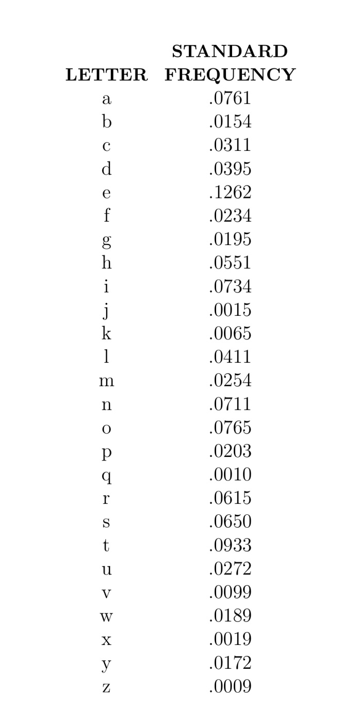
Simple coding strategies
Transliteration schemes and substitution ciphers
These kinds of codes can be fairly easily deciphered.
How?
By working out the frequency of the occurrence of each letter we can decode a message.

Slide 19
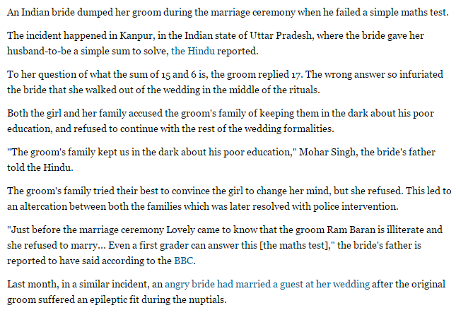

Slide 21
A more sophisticated scheme
How can we transmit a password, e.g., to enable subscribers of a TV network provider to view their channels, without other people intercepting this?

Slide 22
A more sophisticated scheme
How can we transmit a password, e.g., to enable subscribers of a TV network provider to view their channels, without other people intercepting this?
Digital information is encoded itself in binary – we use this to create a password and a key structure.

Slide 23
A more sophisticated scheme
How can we transmit a password, e.g., to enable subscribers of a TV network provider to view their channels, without other people intercepting this?
Digital information is encoded itself in binary – we use this to create a password and a key structure.
The solution is to use a password and a key.
Each subscriber has a separate key.
The service provider sends out a series of codes, each of which contains the password to unlock the channels when combined with the key of a given individual is used.

Slide 24
A more sophisticated scheme
A TV service provider will send out many of these codes (for all of the subscribers). The user’s box will then filter through all of these codes, applying their key, until the screen becomes clear.

Slide 25
A more sophisticated scheme
A TV service provider will send out many of these codes (for all of the subscribers). The user’s box will then filter through all of these codes, applying their key, until the screen becomes clear.
For an interceptor it is very difficult to extract the password from the codes that are sent out.

Slide 26
Cryptography: Summary of lecture 13
How can we transmit information secretly across a public network?

Slide 27
Cryptography: Summary of lecture 13
How can we transmit information secretly across a public network?
Transmitting information openly clearly doesn’t work.

Slide 28
Cryptography: Summary of lecture 13
How can we transmit information secretly across a public network?
Transmitting information openly clearly doesn’t work. I haven’t showered in five days…

Slide 29
Cryptography: Summary of lecture 13
How can we transmit information secretly across a public network?
Transmitting information openly clearly doesn’t work. I haven’t showered in five days…
If we send a key separately to the receiver and then a locked message this works…

Slide 30
Cryptography: Summary of lecture 13
How can we transmit information secretly across a public network?
Transmitting information openly clearly doesn’t work. I haven’t showered in five days…
If we send a key separately to the receiver and then a locked message this works… provided the interceptor doesn’t make a copy of the key.

Slide 31
Cryptography: Summary of lecture 13
How can we transmit information secretly across a public network?
Transmitting information openly clearly doesn’t work. I haven’t showered in five days…
If we send a key separately to the receiver and then a locked message this works… provided the interceptor doesn’t make a copy of the key.
If we send a box with an open padlock in that we have the key to, then the receiver can write the message, place in the box and lock. Only we can open the box. This works…(I still don’t know what Isabel wrote in her message) but how does this translate to sending information across the internet?

Slide 32
Cryptography: Summary of lecture 13
How can we transmit information secretly across a public network?
Transmitting information openly clearly doesn’t work. I haven’t showered in five days…
If we send a key separately to the receiver and then a locked message this works… provided the interceptor doesn’t make a copy of the key.
If we send a box with an open padlock in that we have the key to, then the receiver can write the message, place in the box and lock. Only we can open the box. This works…(I still don’t know what Isabel wrote in her message) but how does this translate to sending information across the internet?

Slide 33
Cryptography: Summary of lecture 13
We are looking for a way to communicate information (e.g., a number) from one place to another in a public way such that only the receiver can decode this.
To do this we need some mathematical tools. The first of these is modular arithmetic.

Slide 34
Cryptography: Summary of lecture 13
We are looking for a way to communicate information (e.g., a number) from one place to another in a public way such that only the receiver can decode this.
To do this we need some mathematical tools. The first of these is modular arithmetic.
Question: When we divide 78125 by 7 what is the remainder?

Slide 35
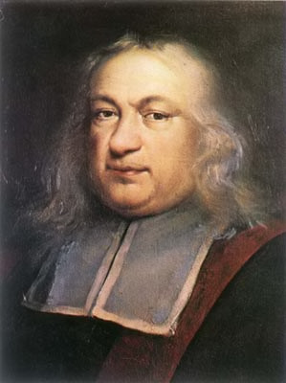
Fermat’s last theorem
And this proposition is generally true for all progressions and for all prime numbers; the proof of which I would send to you, if I were not afraid to be too long.
Pierre de Fermat
1601 –1665

Slide 36
Andrew Wiles

Slide 37
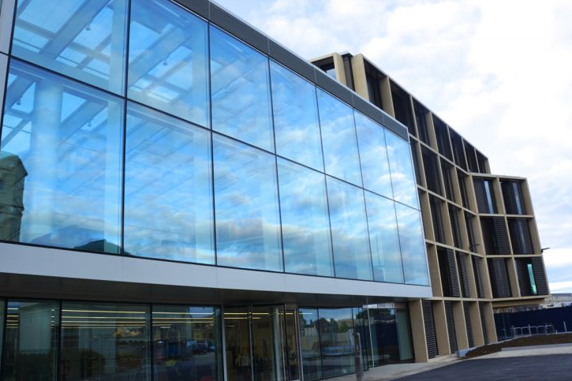
Andrew Wiles
The Andrew Wiles Building,
Mathematical Institute, University of Oxford

Slide 38
Some announcements
Feng Zhu’s office hour next week will be from 11-midday on Friday in the Common Room (instead of 4-5pm on Monday).

Slide 39
Some announcements
Feng Zhu’s office hour next week will be from 11-midday on Friday in the Common Room (instead of 4-5pm on Monday).
Heather Macbeth will not be giving an office hour this week (normally Wednesdays 2–3pm).

Slide 40
Summary of lecture 14
We are looking for a way to communicate information (e.g., a number) from one place to another in a public way such that only the receiver can decode this.

Slide 41
Summary of lecture 14
There are three useful properties of modular arithmetic. Property 1

Slide 42
Summary of lecture 14
There are three useful properties of modular arithmetic. Property 1 If and then Property 2 Property 3
Property 3 is useful in calculating the remainder for very large numbers and is a crucial ingredient in cryptography.

Slide 43
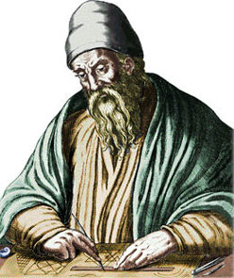
Euclid
“The date and place of Euclid's birth and the date and circumstances of his death are unknown.”

Slide 44
Midterm Essays
If you wrote your essay on mathematics relating to nature or art then these have not yet been graded by the grader assigned to these ☹ They should hopefully be done by the end of today!
On each of the midterm essays I have tried to include a way of improving your grade even further for next time.

Slide 45
Summary of lecture 15
We are looking for a way to communicate information (e.g., a number) from one place to another in a public way such that only the receiver can decode this.
To do this we need modular arithmetic and the Euclidean algorithm.
Today: we will see how this all fits together.
We will also do some magic ☺

Slide 46
Summary of lecture 15
We are looking for a way to communicate information (e.g., a number) from one place to another in a public way such that only the receiver can decode this.
To do this we need modular arithmetic and the Euclidean algorithm.
Today: we will see how this all fits together.
We will also do some magic ☺

