Slide 1
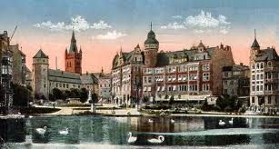
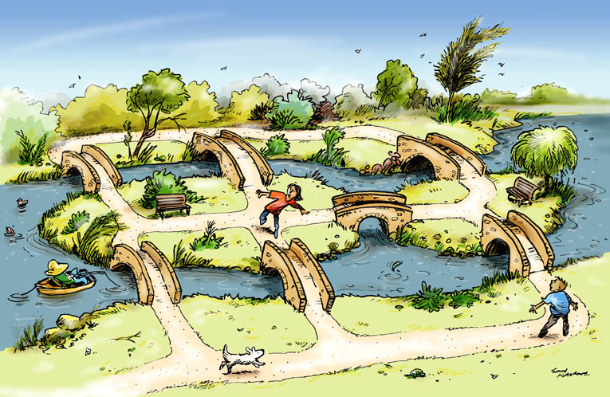
The seven bridges of Königsberg
The city of Königsberg (formerly in Prussia, now a part of Russia and called Kaliningrad) is split by the River Pregel into various parts (including the island Kniephof), and back in the day there were seven bridges connecting the various parts, as you can see in the drawing below:

Slide 2
The seven bridges of Königsberg
The city-folk wanted to know if it was possible to make a walking tour of the city, starting and ending at the same place, in such a way that the walkers crossed each bridge exactly once.

Slide 3
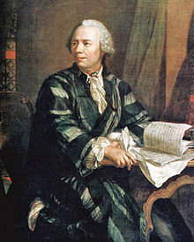
Leonhard Euler
1707–1783

Slide 4
MAT199: Math Alive
Graph theory
Ian Griffiths
Mathematical Institute, University of Oxford,
Department of Mathematics, Princeton University

Slide 5
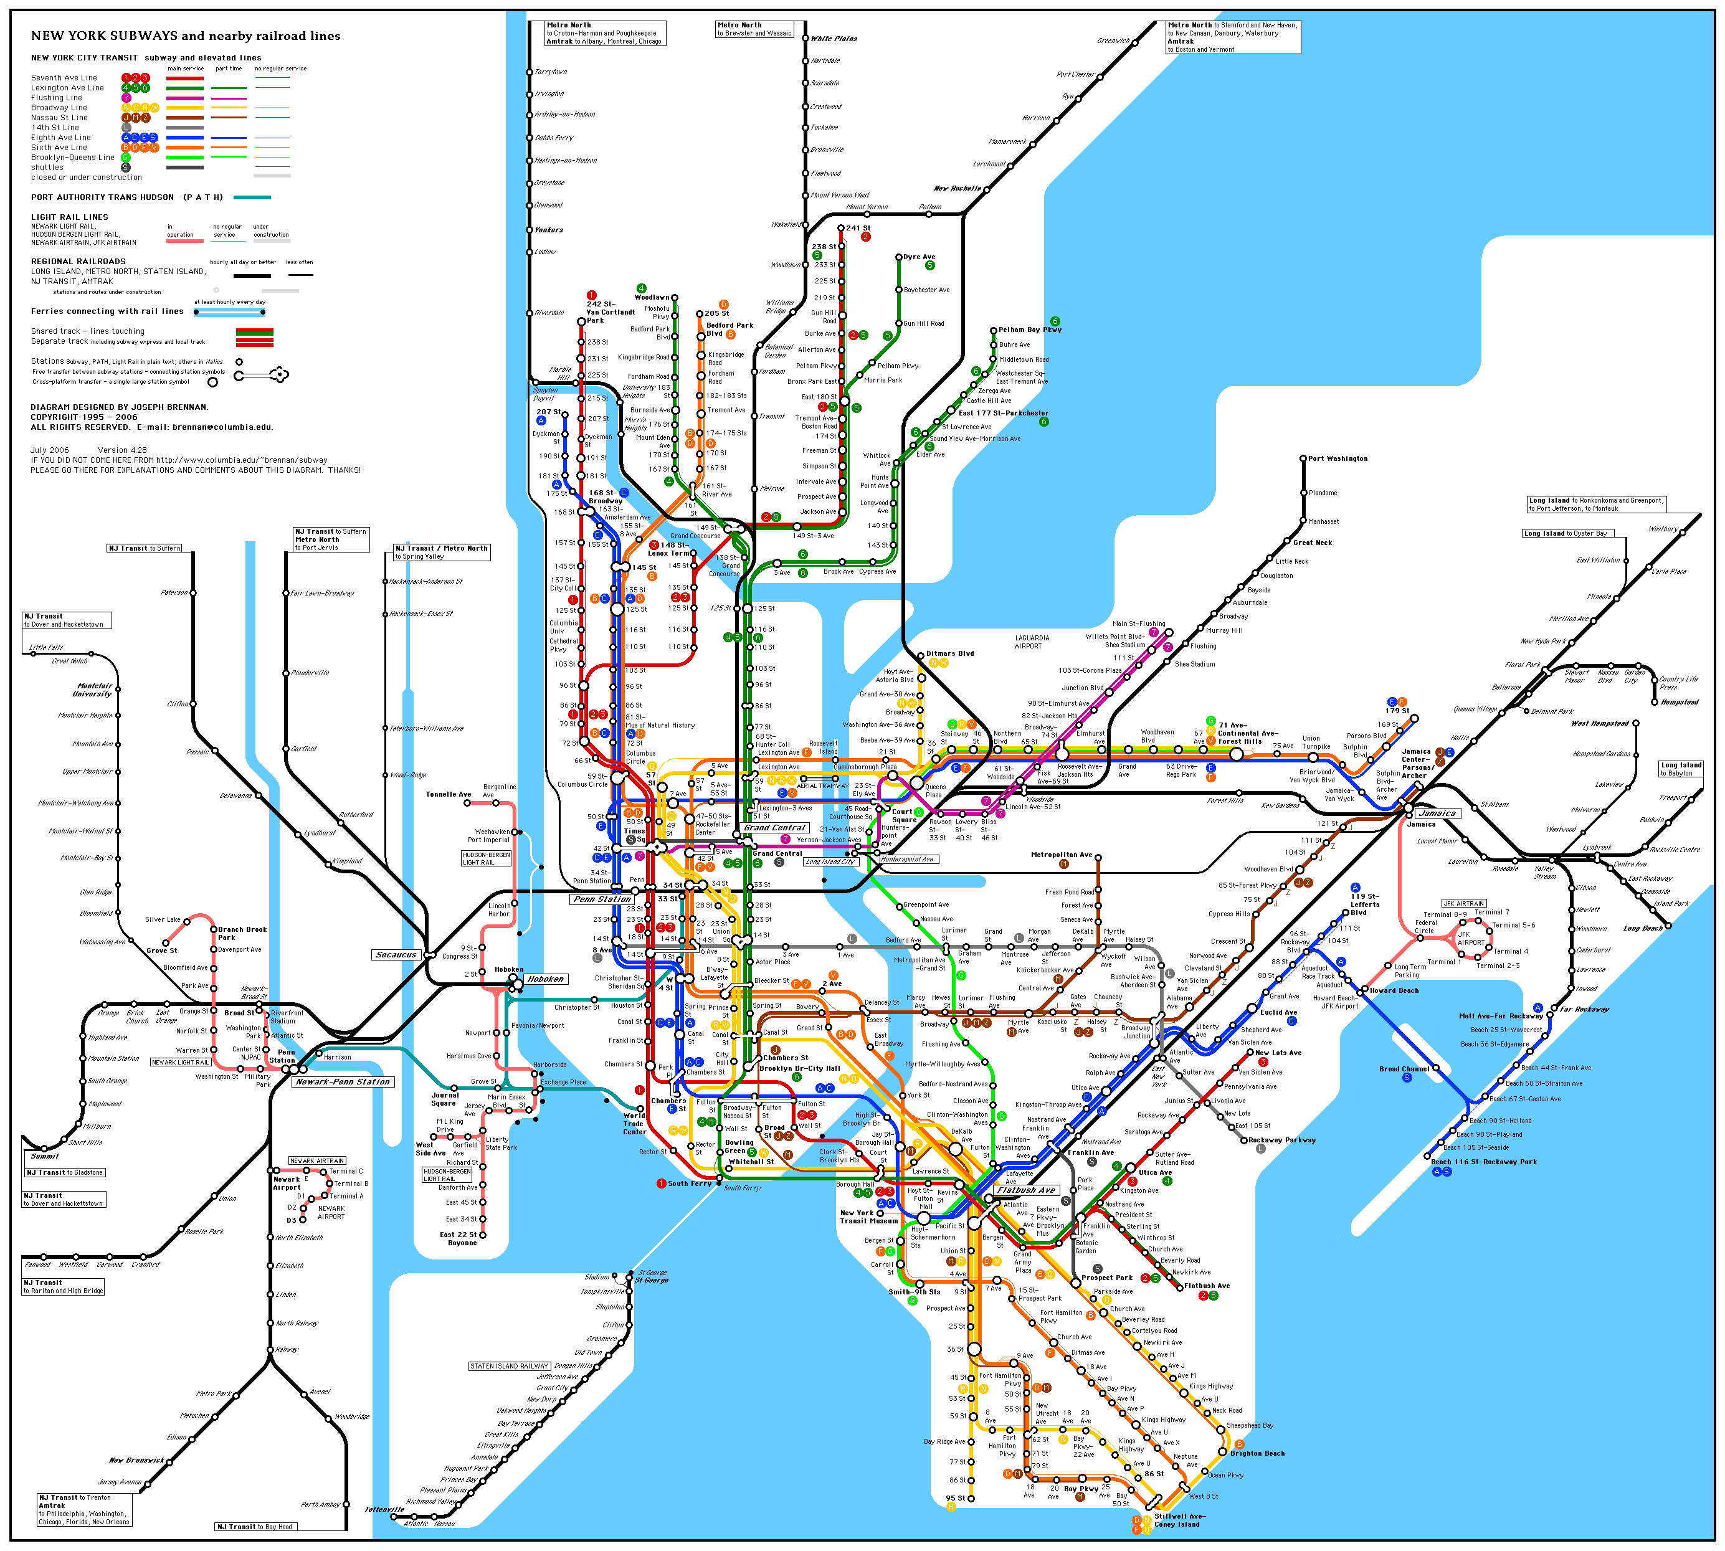
Examples of graphs
The New York City Subway map.

Slide 6
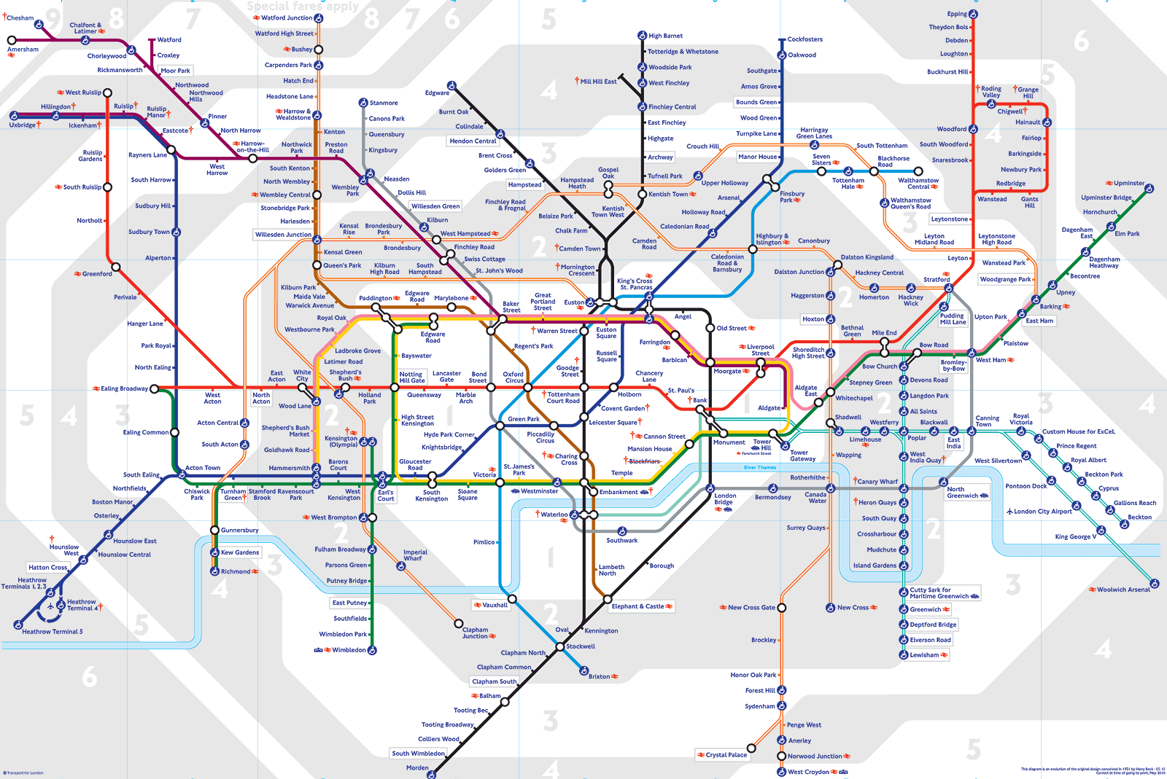
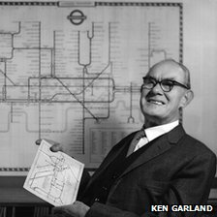
Examples of graphs
The London Underground map.
This map celebrates is 80th anniversary this year and was designed by Harry Beck.

Slide 7
Summary of lecture
The Königsberg bridge problem.
A graph is an assembly of vertices (points) and edges. The only rule is that each edge starts at a vertex and ends at a vertex.

Slide 8
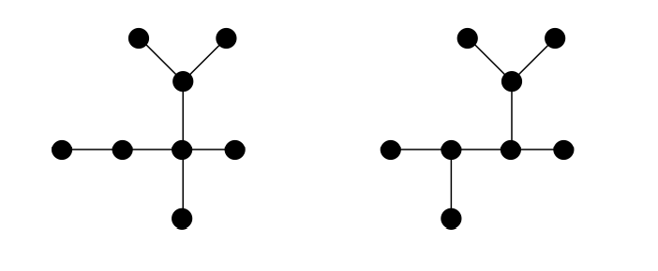
Isomorphisms
Are these two graphs isomorphisms?

Slide 9
Isomorphisms
Are these two graphs isomorphisms?
What about these?

Slide 10
Summary of lecture
Graph theory provides a simple way of visualizing geometrical questions such as the Königsberg bridge problem – the resulting graphs capture the key geometrical information we need.
Graphs are composed of vertices (islands) and edges (bridges).
Directed graphs contain extra information that restricts which direction we can travel in.
The degree of a vertex is the number of edges emanating from it.
A route that starts and ends at the same vertex and traverses each edge once only is called an Eulerian circuit.
Theorem: A graph has an Eulerian circuit if and only if all vertices have an even degree.

Slide 11
Six degrees of separation

Slide 12
Six degrees of separation
Everyone and everything is six or fewer steps away.

Slide 13
Six degrees of separation
Everyone and everything is six or fewer steps away.
In 2001, Duncan Watts, a professor at Columbia University recreated this experiment on the Internet, using an email message as the "package" that needed to be delivered, with 48,000 senders and 19 targets (in 157 countries). Watts found that the average (though not maximum) number of intermediaries was around six.

Slide 14
Six degrees of separation
Everyone and everything is six or fewer steps away.
In 2001, Duncan Watts, a professor at Columbia University recreated this experiment on the Internet, using an email message as the "package" that needed to be delivered, with 48,000 senders and 19 targets (in 157 countries). Watts found that the average (though not maximum) number of intermediaries was around six.
A 2007 study by Jure Leskovec and Eric Horvitz examined a data set of instant messages composed of 30 billion conversations among 240 million people. They found the average path length among Microsoft Messenger users to be 6.6.

Slide 15
Six degrees of separation
Everyone and everything is six or fewer steps away.
In 2001, Duncan Watts, a professor at Columbia University recreated this experiment on the Internet, using an email message as the "package" that needed to be delivered, with 48,000 senders and 19 targets (in 157 countries). Watts found that the average (though not maximum) number of intermediaries was around six.
A 2007 study by Jure Leskovec and Eric Horvitz examined a data set of instant messages composed of 30 billion conversations among 240 million people. They found the average path length among Microsoft Messenger users to be 6.6.
An optimal algorithm to calculate degrees of separation in social networks: Bakhshandeh et al. have addressed the search problem of identifying the degree of separation between two users in social networks such as Twitter. They have introduced new search techniques to provide optimal or near optimal solutions. The experiments show an improvement of several orders of magnitude over greedy approaches. Their optimal algorithm finds an average degree of separation of 3.43 between two random Twitter users, requiring an average of only 67 requests for information over the Internet to Twitter. A near-optimal solution of length 3.88 can be found by making an average of 13.3 requests.

Slide 16
Six degrees of separation
The game Six Degrees of Kevin Bacon was invented as a play on the concept: the goal is to link any actor to Kevin Bacon through no more than six connections.
In September, 2012, Google made it possible to search for any given actor's 'Bacon Number' through their search engine.

Slide 17
Six degrees of separation
The game Six Degrees of Kevin Bacon was invented as a play on the concept: the goal is to link any actor to Kevin Bacon through no more than six connections.
In September, 2012, Google made it possible to search for any given actor's 'Bacon Number' through their search engine.
Mathematicians use an analogous notion of collaboration distance: two people are linked if they are coauthors of an article.
The collaboration distance with mathematician Paul Erdös is known as the Erdös number.

Slide 18
Six degrees of separation
The game Six Degrees of Kevin Bacon was invented as a play on the concept: the goal is to link any actor to Kevin Bacon through no more than six connections.
In September, 2012, Google made it possible to search for any given actor's 'Bacon Number' through their search engine.
Mathematicians use an analogous notion of collaboration distance: two people are linked if they are coauthors of an article.
The collaboration distance with mathematician Paul Erdös is known as the Erdös number.
A Facebook platform application named "Six Degrees" was developed by Karl Bunyan, which calculates the degrees of separation between different people. It had over 5.8 million users, as seen from the group's page. The average separation for all users of the application is 5.73 degrees, whereas the maximum degree of separation is 12.

Slide 19
Summary of lecture
Graph theory provides a simple way of visualizing geometrical questions such as the Königsberg bridge problem – the resulting graphs capture the key geometrical information we need.

Slide 20
Summary of lecture
Graph theory provides a simple way of visualizing geometrical questions such as the Königsberg bridge problem – the resulting graphs capture the key geometrical information we need.
Graphs are composed of vertices (islands) and edges (bridges).

Slide 21
Summary of lecture
Graph theory provides a simple way of visualizing geometrical questions such as the Königsberg bridge problem – the resulting graphs capture the key geometrical information we need.
Graphs are composed of vertices (islands) and edges (bridges).
Directed graphs contain extra information that restricts which direction we can travel in.
The distance between two points is the shortest number of edges that must be traversed to go between the two points.

Slide 22
Summary of lecture
Graph theory provides a simple way of visualizing geometrical questions such as the Königsberg bridge problem – the resulting graphs capture the key geometrical information we need.
Graphs are composed of vertices (islands) and edges (bridges).
Directed graphs contain extra information that restricts which direction we can travel in.
The distance between two points is the shortest number of edges that must be traversed to go between the two points.
The diameter of a graph is the maximum distance between any two vertices in the graph.

Slide 23
Summary of lecture
Graph theory provides a simple way of visualizing geometrical questions such as the Königsberg bridge problem – the resulting graphs capture the key geometrical information we need.
Graphs are composed of vertices (islands) and edges (bridges).
Directed graphs contain extra information that restricts which direction we can travel in.
The distance between two points is the shortest number of edges that must be traversed to go between the two points.
The diameter of a graph is the maximum distance between any two vertices in the graph.
The number of edges attached to a vertex is called the degree.

Slide 24
Summary of lecture
Graph theory provides a strategic way of determining an optimal route for a parcel delivery service, garbage truck or street cleaner that minimizes the number of roads that are repeated.
If all vertices in the graph have even degree then we know that an Eulerian circuit exists and we do not have to repeat any roads.
If some vertices have odd degree then we must add extra edges until all the vertices do have even degree – this is called Eulerizing the graph.
Adding extra edges corresponds in practice to repeating roads.

Slide 25
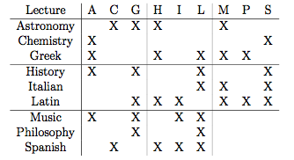
Graph colouring

Slide 26
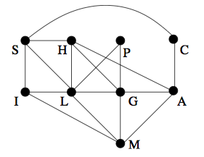
Graph colouring

Slide 27
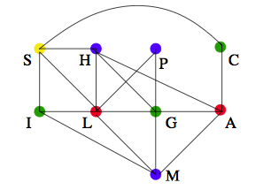
Graph colouring

Slide 28
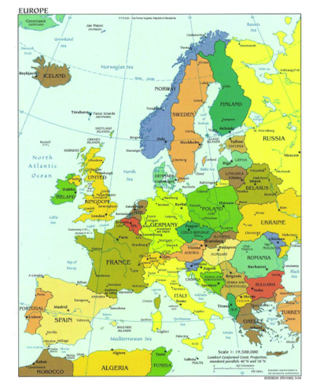
Map colouring
Consider a map:

Slide 29
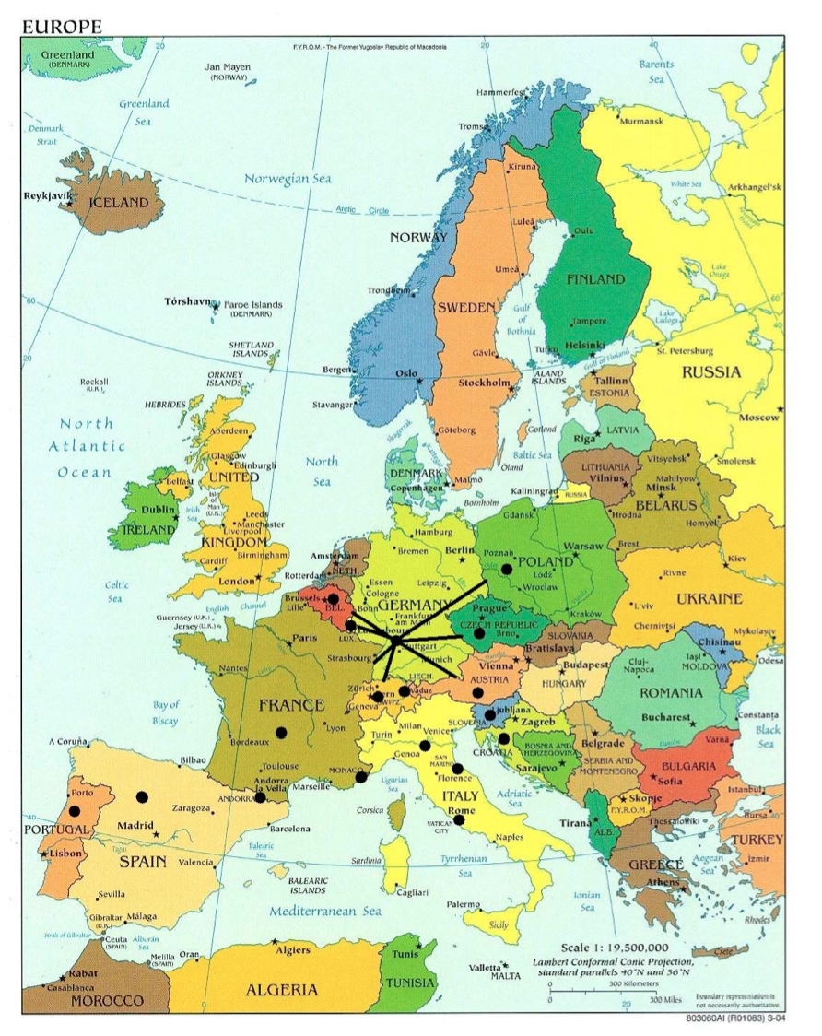
Map colouring
Place dots at the centre of each country and then join the dots for countries lying next to one another:

Slide 30
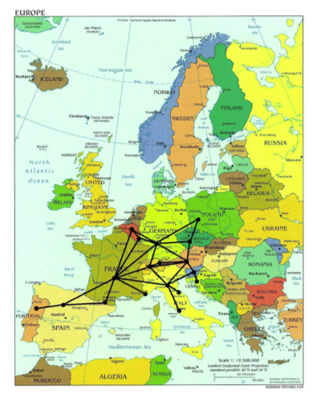
Map colouring
Continue joining the dots:

Slide 31
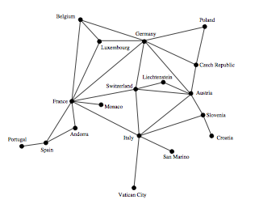
Map colouring
Take away the map:

Slide 32
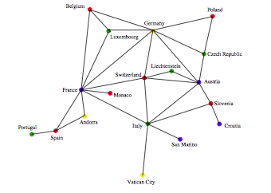
Map colouring
And colour appropriately:
Here we needed to use four colours to achieve a proper colouring – red, black, blue and yellow.

Slide 33
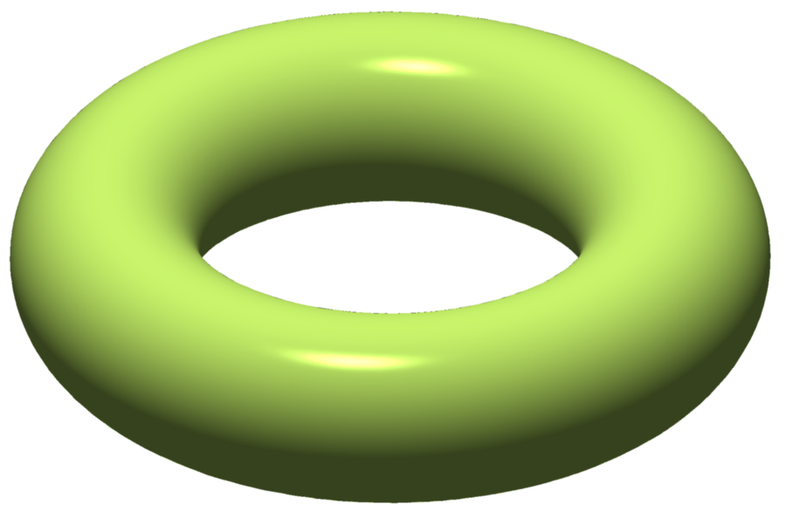
Euler characteristics
This equation can be generalized for shapes with holes in: χ = F - E + V = 2 - 2g where g= number of holes
e.g., torus (doughnut) has an Euler characteristic of zero:

Slide 34
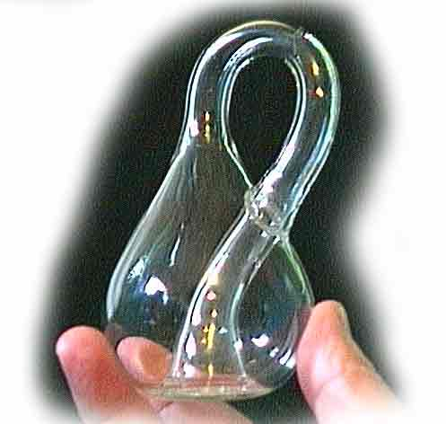
Euler characteristics
A Klein bottle has Euler characteristic zero:

Slide 35
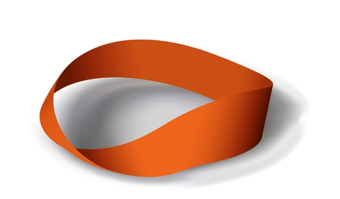
Euler characteristics
A Möbius strip has Euler characteristic zero:
Notes:
Wind up music box http://www.youtube.com/watch?v=3iMI_uOM_fY
Wind and Mr Ug. http://www.youtube.com/watch?v=4mdEsouIXGM
Mobius bagel: http://www.youtube.com/watch?v=dN8AwGUaqDA

Slide 36
Euler characteristics
A Möbius strip has Euler characteristic zero:
The National Library of Kazakhstan
Notes:
Wind up music box http://www.youtube.com/watch?v=3iMI_uOM_fY
Wind and Mr Ug. http://www.youtube.com/watch?v=4mdEsouIXGM
Mathematically correct breakfast: http://www.youtube.com/watch?v=dN8AwGUaqDA

Slide 40
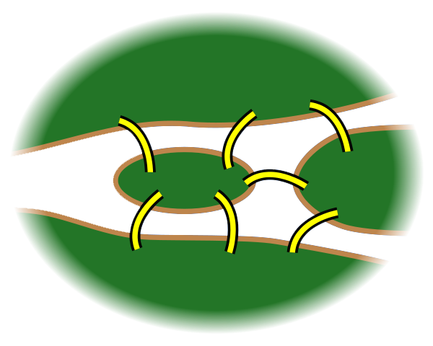
The seven bridges of Königsberg
Pregel River
Kneiphof

