Slide 1
Closing the Cycle through innovation in teaching and learning mathematics in Africa
Michael Obiero Oyengo
Maseno University Kenya
The Africa Oxford Initiative
27th November 2018

Slide 2
Experiences during doctoral studies (U.S.A.)
After PhD studies. (Maseno)
What can be done moving forward
Pre-doctoral experiences
(Africa)

Slide 3
Pre-doctoral experiences
Egerton and Maseno university
Mentors Mr Osango and David Stern at undergraduate and master’s level.
Obvious challenges in most African Institutions that affect learning (from large classes, inability to access extra help from lecturers, inadequate learning resources)
Not pushed enough academically partly due to the inadequacies of my learning environment.
Desire for a new challenge in a new environment.

Slide 4
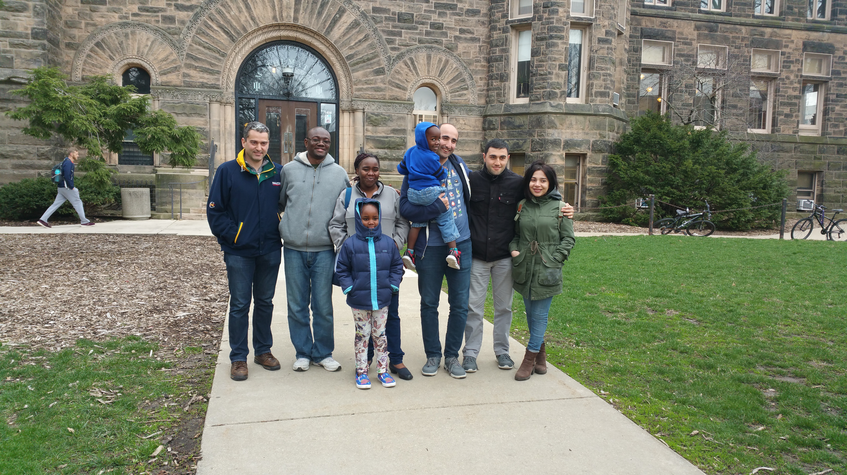
PhD Studies
A new experience at Urbana-Champaign
New culture in the university environment (interaction between students and professors)
Competitive environment
Challenges and overcoming them

Slide 5
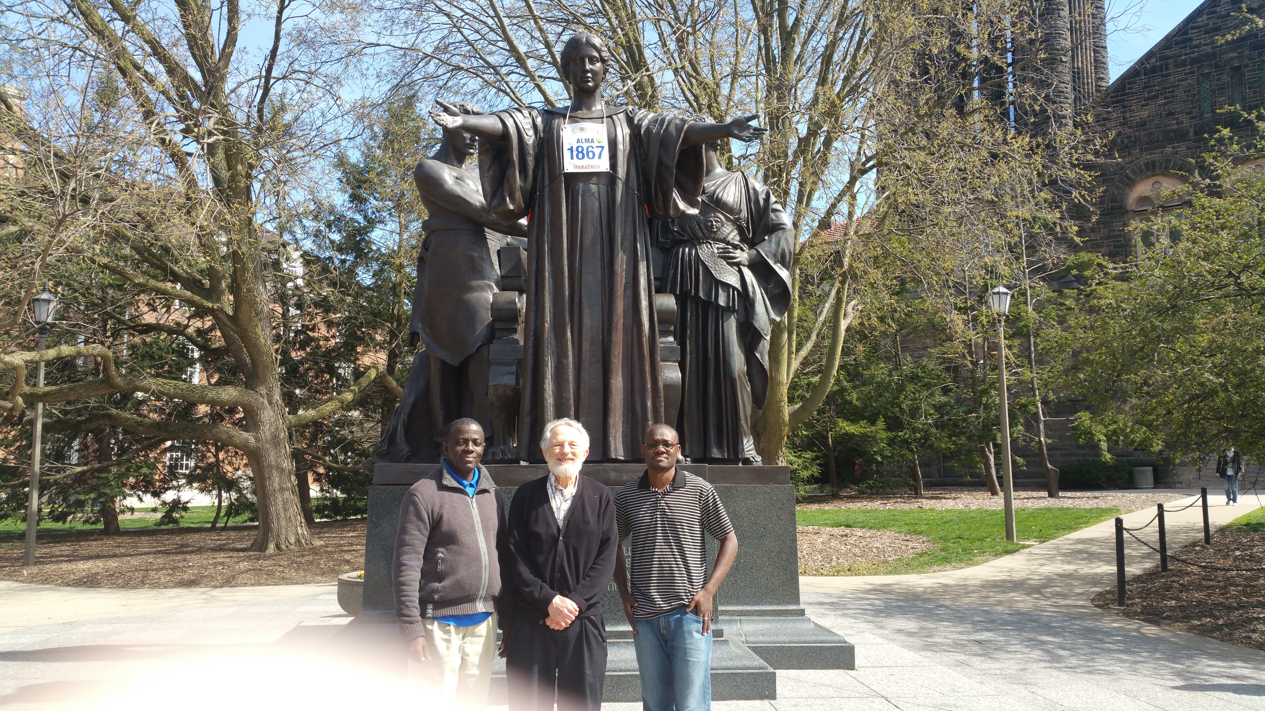
PhD Studies and life in the U.S.
Prof Kenneth Stolarsky and Kepher Asunga
Research on the geometry of polynomial sequences and continued fractions of quadratic irrationals.
Research interests are geometry of rationally generated polynomials, continued fractions and in analysis
Innovation in teaching and learning of maths. TA at NetMath in Champaign Urbana.

Slide 6
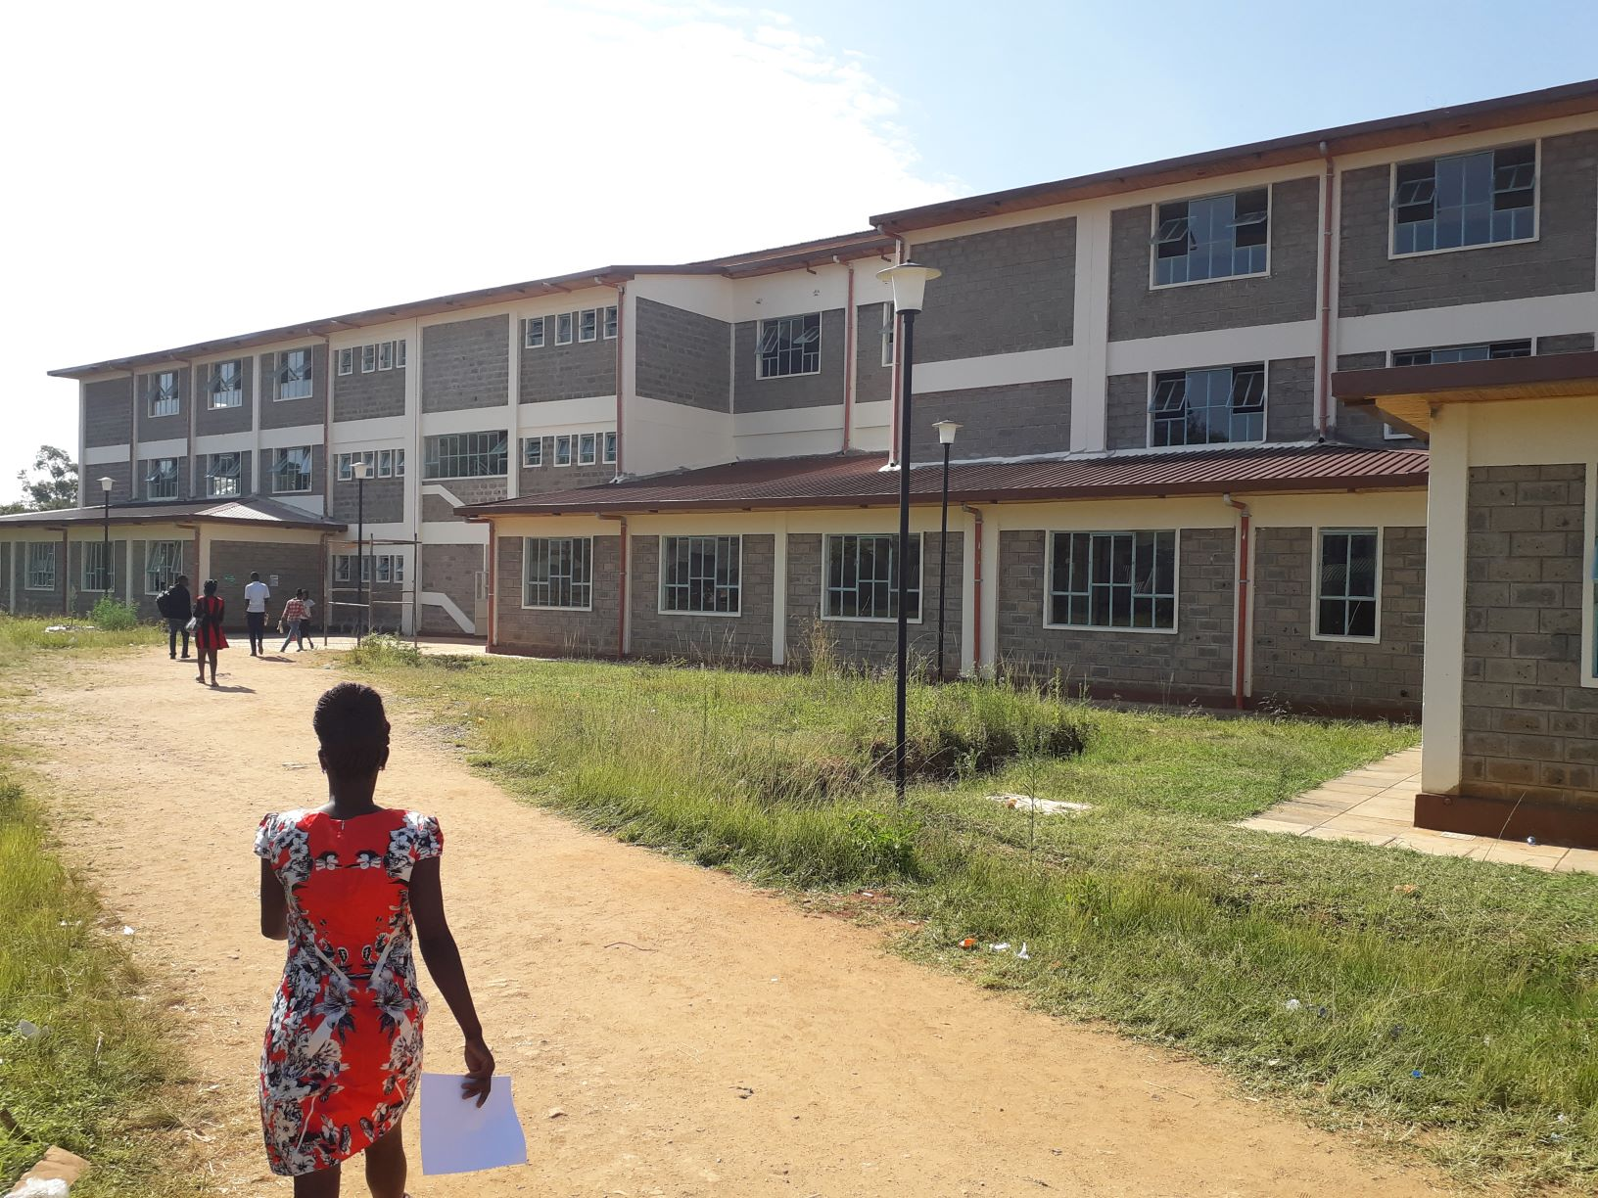
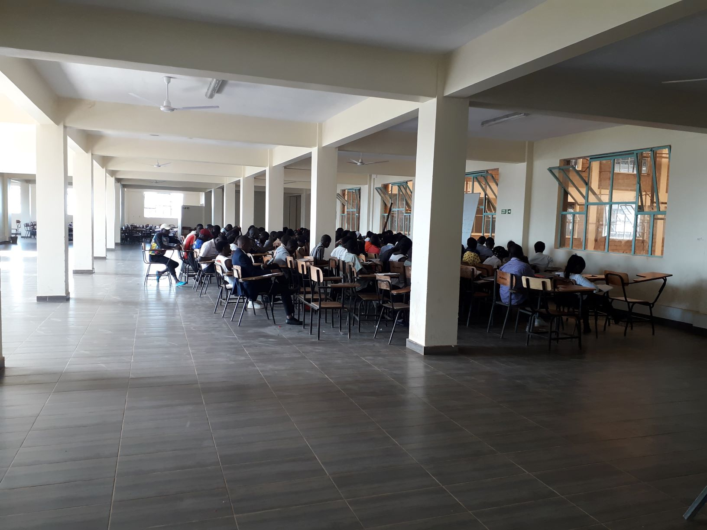
Back to Africa, lessons being learned

Slide 7
Back to Africa, lessons being learned
Teaching duties and how they potentially affect effectiveness in teaching and research
Expectations from the university (teach a minimum of two classes every semester and do research)
Uniqueness of Maseno (Young lecturers who have recently completed their PhDs)
Creative ways of easing the burden on lecturers while improving the quality of education received by undergraduates.
Better trained undergraduate students enthusiastic for research and further studies
How in the long run this will create a rich environment for research

Slide 8
Thank you

